Slide 1
CS443 - Data Structures & Algorithms Infix to Postfix, Prefix Conversion & Evaluation

Slide 2
What is an Expression?
An expression in math is a sentence with a minimum of two numbers or variables and at least one math operation. This math operation can be addition, subtraction, multiplication, or division. The structure of an expression is:
Expression is (Number/variable, Math Operator, Number/variable)
Example 1: | 7+9
Example 2: | 23.5 x 4
Example 3: | 37s – 6t
Example 4: | 25a4 + 9 – 4 / 15

Slide 3
In this Lecture we’re going to discuss three notations
Infix Notation
Prefix Notation
Postfix Notation
Infix Expression | Prefix Expression | Postfix Expression
A + B | + A B | A B +
A + B * C | + A * B C | A B C * +

Slide 4
What is Infix notation?
When the operator is written in between the operands, then it is known as infix notation. Operand does not have to be always a constant or a variable; it can also be an expression itself.
For example,
(p + q) * (r + s)
In the above expression, both the expressions of the multiplication operator are the operands, i.e., (p + q), and (r + s) are the operands.

Slide 5
What is Infix notation?
In the previous expression, there are three operators. The operands for the first plus operator are p and q, the operands for the second plus operator are r and s.
While performing the operations on the expression, we need to follow some set of rules to evaluate the result.
In the previous expression, addition operation would be performed on the two expressions, i.e., p+q and r+s, and then the multiplication operation would be performed.

Slide 6
Syntax of infix notation is given below:
<operand> <operator> <operand>
If there is only one operator in the expression, we do not require applying any rule. For example, 5 + 2; in this expression, addition operation can be performed between the two operands (5 and 2), and the result of the operation would be 7.
If there are multiple operators in the expression, then some rule needs to be followed to evaluate the expression.
If the expression is:
4 + 6 * 2
-If the plus operator is evaluated first, then the expression would look like:
10 * 2 = 20
-If the multiplication operator is evaluated first, then the expression would look like:
4 + 12 = 16

Slide 7
Operator’s Precedence
The previous discussed problem can be resolved by following the operator precedence rules. In the algebraic expression, the order of the operator precedence is given in the below table:
Operators | Symbols
Parenthesis | ( ), {}, [ ]
Exponents | ^
Multiplication and Division | *, /
Addition and Subtraction | + , -

Slide 8
The first preference is given to the parenthesis; then next preference is given to the exponents. In the case of multiple exponent operators, then the operation will be applied from right to left.
For example:
2^2^3 = 2 ^ 8 = 256
After exponent, multiplication, and division operators are evaluated. If both the operators are present in the expression, then the operation will be applied from left to right.
The next preference is given to addition and subtraction. If both the operators are available in the expression, then we go from left to right.
The operators that have the same precedence termed as operator associativity. If we go from left to right, then it is known as left-associative. If we go from right to left, then it is known as right-associative.

Slide 9
Associativity Order
Associativity means when the operators with the same precedence exist in the expression.
For example, in the expression, i.e., A + B - C, '+' and '-' operators are having the same precedence, so they are evaluated with the help of associativity.
Since both '+' and '-' are left-associative, they would be evaluated as (A + B) - C.
Operators | Associativity
^ | Right to Left
*, / | Left to Right
+, - | Left to Right

Slide 10
Problem with Infix notation
To evaluate the infix expression, we should know about the operator precedence rules, and if the operators have the same precedence, then we should follow the associativity rules.
The use of parenthesis is very important in infix notation to control the order in which the operation to be performed. Parenthesis improves the readability of the expression.
An infix expression is the most common way of writing expression, but it is not easy to parse and evaluate the infix expression without ambiguity.

Slide 11
Problem with Infix notation
So, mathematicians and logicians studied this problem and discovered two other ways of writing expressions which are prefix and postfix.
Both expressions do not require any parenthesis and can be parsed without ambiguity.
It does not require operator precedence and associativity rules.

Slide 12

Postfix Expressions

Slide 13
Postfix Expression
The postfix expression is an expression in which the operator is written after the operands. For example, the postfix expression of infix notation (2+3) can be written as 23+. It is also known as Reverse Polish Notation.
Syntax of postfix notation is given below:
<operand> <operand> <operator>
Some key points regarding the postfix expression are:
In postfix expression, operations are performed in the order in which they have written from left to right.
It does not any require any parenthesis.
We do not need to apply operator precedence rules and associativity rules.

Slide 14
Conversion of Infix to Postfix
Here, we will use the stack data structure for the conversion of infix expression to prefix expression. Whenever an operator will encounter, we push operator into the stack. If we encounter an operand, then we append the operand to the expression.
Rules for the conversion from infix to postfix expression
Print the operand as they arrive.
If the stack is empty or contains a left parenthesis on top, push the incoming operator on to the stack.
If the incoming symbol is '(', push it on to the stack.
If the incoming symbol is ')', pop the stack and print the operators until the left parenthesis is found.

Slide 15
Conversion of Infix to Postfix
If the incoming symbol has higher precedence than the top of the stack, push it on the stack.
If the incoming symbol has lower precedence than the top of the stack, pop and print the top of the stack. Then test the incoming operator against the new top of the stack.
If the incoming operator has the same precedence with the top of the stack, then use the associativity rules. If the associativity is from left to right, then pop and print the top of the stack then push the incoming operator. If the associativity is from right to left, then push the incoming operator.
At the end of the expression, pop and print all the operators of the stack.

Slide 16
Conversion of Infix to Postfix
Let's understand through an example.
Infix expression: K + L - M*N + (O^P) * W/U/V * T + Q
Input Expression | Stack | Postfix Expression
K
empty
K
+
+
K
L
+
KL
-
-
KL +
M
-
KL + M
*
- *
KL + M
N
- *
KL + MN

Slide 17
Input Expression | Stack | Postfix Expression
K L + M N *
K L + M N * -
+
+
(
+ (
K L + M N * -
O
+ (
K L + M N * - O
^
+ ( ^
K L + M N * - O P
P
+ ( ^
K L + M N * - O P
)
+
K L + M N * - O P ^
*
+ *
K L + M N * - O P ^
W
+ *
K L + M N * - O P ^ W
/
+ /
K L + M N * - O P ^ W *
U
+ /
K L + M N * - O P ^ W * U
/
+ /
K L + M N* - O P ^W*U/
V
+ /
K L + M N* - O P ^W*U/ V

Slide 18
Input Expression | Stack | Postfix Expression
+ *
KL+MN*-OP^W*U/V/
*
T
+ *
KL+MN*-OP^W*U/V/T
+
KL+MN*-OP^W*U/V/T* KL+MN*-OP^W*U/V/T*+
+
Q
+
KL+MN*-OP^W*U/V/T*Q
KL+MN*-OP^W*U/V/T*+Q+
The final postfix expression of infix expression
(K + L - M*N + (O^P) * W/U/V * T + Q)
is
KL+MN*-OP^W*U/V/T*+Q+

Slide 19
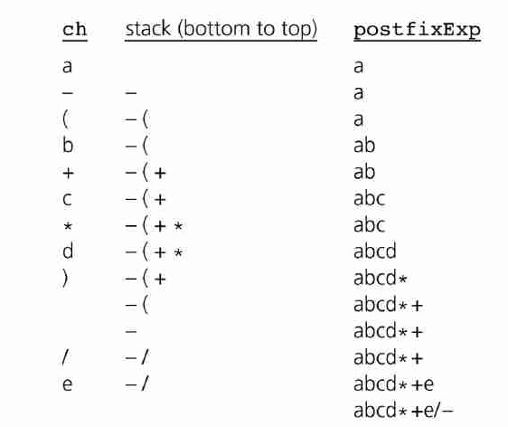
Self Test-1
What is Postfix expression for the following infix expression?
a – ( b + c * d ) / e
Solution:
a b c d * + e / -

Slide 20
Evaluation of Postfix Expression

Slide 21
Evaluating Postfix Expression
Algorithm to evaluate the postfix expression
Scan the expression from left to right until we encounter any operator.
Perform the operation
Replace the expression with its computed value.
Repeat the steps from 1 to 3 until no more operators exist.

Slide 22
Evaluating Postfix Expression
Let's understand the above algorithm through an example.
Infix expression: 2 + 3 * 4
We will start scanning from the left most of the expression. The multiplication operator is an operator that appears first while scanning from left to right. Now, the expression would be:
Expression = 2 + 34* = 2 + 12
Again, we will scan from left to right, and the expression would be:
Expression = 2 12 + = 14

Slide 23
Postfix Expression
Evaluation of postfix expression using stack.
Scan the expression from left to right.
If we encounter any operand in the expression, then we push the operand in the stack.
When we encounter any operator in the expression, then we pop the corresponding operands from the stack.
When we finish with the scanning of the expression, the final value remains in the stack.

Slide 24
Let's understand the evaluation of postfix expression using stack.
Example 1: Postfix expression: 2 3 4 * +
The result of the above expression is 14.
Input | Stack (bottom to top) | Action
2 3 4 * +
empty
Push 2
3 4 * +
2
Push 3
4 * +
2 3
Push 4
2 3 4
Pop 4 and 3 and perform 4*3 = 12. Push 12 into the stack.
* +
+
2 12
Pop 12 and 2 from the stack and perform 12+2 = 14. Push 14 into the stack.

Slide 25
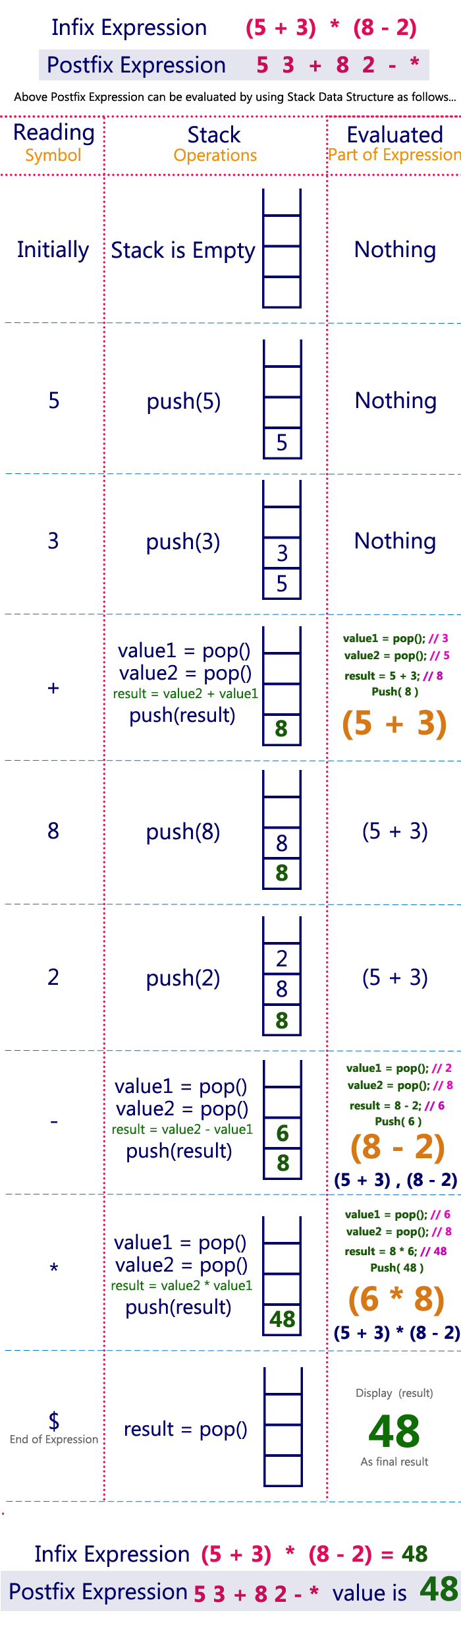

Slide 27
Self Test-2
What is the result of evaluation for the following postfix expression?
2 3 4 + 5 6 - - *
Answer:
16

Slide 28
Prefix Expressions

Slide 29
What is Prefix conversion?
An infix expression is an expression in which the operators are written between the two operands.
If we move the operator before the operands, then it is known as a prefix expression.
In other words, prefix expression can be defined as an expression in which all the operators precede the two operands.
In this notation, operator is prefixed to operands, i.e., operator is written ahead of operands. For example, +ab. This is equivalent to its infix notation a + b. Prefix notation is also known as Polish Notation.

Slide 30
What is Prefix conversion?
Syntax of postfix notation is given below:
<operator> <operand> <operand>
For example, if the infix expression is 5+1, then the prefix expression corresponding to this infix expression is +51.
If the infix expression is:
a * b + c
↓
*ab+c
↓
+*abc (Prefix expression)

Slide 31
What is Prefix conversion?
A + B * C
First scan: In the above expression, multiplication operator has a higher precedence than the addition operator; the prefix notation of B*C would be (*BC).
A + *BC
Second scan: In the second scan, the prefix would be:
+A *BC
In the above expression, we use two scans to convert infix to prefix expression.
If the expression is complex, then we require a greater number of scans. We need to use that method that requires only one scan and provides the desired result.
If we achieve the desired output through one scan, then the algorithm would be efficient. This is possible only by using a stack.

Slide 32
Conversion of Infix to Prefix
If we are converting the expression from infix to prefix, we need first to reverse the expression
Rules for the conversion from infix to postfix expression
First, reverse the infix expression given in the problem.
Scan the expression from left to right.
Whenever the operands arrive, print them.
If the operator arrives and the stack is found to be empty, then simply push the operator into the stack.
If the incoming operator has higher precedence than the TOP of the stack, push the incoming operator into the stack.

Slide 33
Conversion of Infix to Prefix
If the incoming operator has the same precedence with a TOP of the stack, push the incoming operator into the stack.
If the incoming operator has lower precedence than the TOP of the stack, pop, and print the top of the stack. Test the incoming operator against the top of the stack again and pop the operator from the stack till it finds the operator of a lower precedence or same precedence.
If the incoming operator has the same precedence with the top of the stack and the incoming operator is ^, then pop the top of the stack till the condition is true. If the condition is not true, push the ^ operator.
When we reach the end of the expression, pop, and print all the operators from the top of the stack.
If the operator is ')', then push it into the stack.

Slide 34
Conversion of Infix to Prefix
If the operator is '(', then pop all the operators from the stack till it finds ) opening bracket in the stack.
If the top of the stack is ')', push the operator on the stack.
At the end, reverse the output.
Let's understand through an example.
Infix expression: K + L - M*N + (O^P) * W/U/V * T + Q
The Reverse expression would be:
Q + T * V/U/W * ) P^O(+ N*M - L + K

Slide 35
Input Expression | Stack | Prefix Expression
Q
empty
Q
+
+
Q
T
+
QT
*
+*
QT
V
+*
QTV
/
+*/
QTV
U
+ */
QTVU
/
+ *//
QTVU
W
+ *//
QTVUW
*
+ *//*
QTVUW
)
+ *//*)
QTVUW
P
+ *//*)
QTVUWP

Slide 36
Input Expression | Stack | Prefix Expression
^
+*//*)^
QTVUWP
O
+*//*)^
QTVUWPO
(
+*//*
QTVUWPO^
+
++
QTVUWPO^*//*
N
++
QTVUWPO^*//*N
*
++*
QTVUWPO^*//*N
M
+ +*
QTVUWPO^*//*NM
-
+ +-
QTVUWPO^*//*NM*
L
++-
QTVUWPO^*//*NM*L
+
++-+
QTVUWPO^*//*NM*L
K
++-+
QTVUWPO^*//*NM*LK
End of the expression
QTVUWPO^*//*NM*LK+-++

Slide 37
Conversion of Infix to Prefix
The above expression, i.e.,
Q T V U W P O ^ * / / * N M * L K + - + +,
is not a final expression. We need to reverse this expression to obtain the prefix expression.
Hence, the final expression will be
+ + - + K L * M N * / / * ^ O P W U V T Q

Slide 38
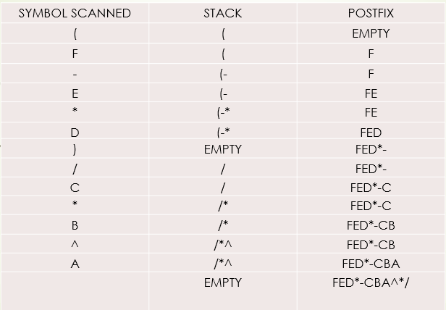
Self Test-3
What is Prefix expression for the following infix expression?
A^B*C/(D*E-F)
Solution:
Now we get the
FED*-CBA^*/ as a
Postfix expression.
Again, we will reverse
the Postfix expression
to get the prefix expression: /*^ABC-*DEF

Slide 39
Evaluation of PREFIX Expression

Slide 40
Evaluating Prefix Expression
Algorithm to evaluate the prefix expression
Start from the last element of the expression.
check the current element.
If it is an operand, push it to the stack
If it is an operator, pop two operands from the stack. Perform the operation and push the elements back to the stack.
Do this till all the elements of the expression are traversed and return the top of stack which will be the result of the operation.

Slide 41
Let's understand the evaluation of prefix expression using stack.
Example: Prefix expression: + 5 * 4 6
The result of the above expression is 29.
Input | Stack (bottom to top) | Action
+ 5 * 4 6
empty
Push 6
+ 5 * 4
6 4
Push 4
+ 5
24
* Is an operator, Pop 4 and 6 and perform 4*6 = 24. Push 24 into the stack.
+
24 5
Push 5
+
29
+ is an operator, Pop 5 and 24 from the stack and perform 24+5 = 29. Push 29 into the stack.
Result
29
29 is the final answer

Slide 42
Prefix Expression
* + 5 3 – 8 2
Prefix Expression
Push (2)
2
Push (8)
Push (8)
8
2
value 1 = pop() //8
Value2 = pop() //2
Result = 8-2 //6
Push(6)
-
-
-
6
(8-2)

Slide 43
3
Push (3)
3
6
5
6
5
Push (5)
3
6
value 1 = pop() //5
Value2 = pop() //3
Result = 5+3 //8
Push(8)
+
+
8
6
(5+3)
Prefix Expression * + 5 3 – 8 2 value is 48

Slide 44
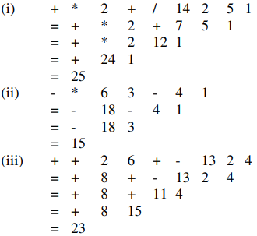
Self Test-4
What is the result of evaluation for the following prefix expressions?
+ * 2 + / 14 2 5 1
– * 6 3 – 4 1
+ + 2 6 + – 13 2 4
Answer:
(i) 25
(ii) 15
(iii) 23

